Slide 1
Eigenvalues and Eigenvectors
4.3 Diagonalization
Bumhee Cho

Slide 2




Diagonalization
A square matrix A is said to be diagonalizable
if A is similar to a diagonal matrix, that is, if A = PDP⁻¹
A² = PDP⁻¹PDP⁻¹
A² = PD²P⁻¹
⋯
A^{k} = PD^{k}P⁻¹

Slide 3




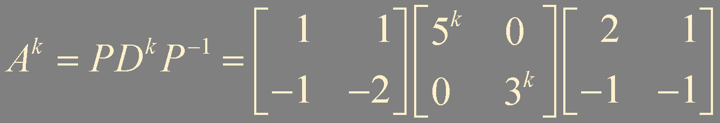

Example 1. A^{k}

Slide 4
Theorem 4. The Diagonalization Theorem
An n × n matrix A is diagonalizable
if and only if A has n linearly independent eigenvectors
In fact, A = PDP⁻¹, with D a diagonal matrix, if and only if the columns of P are n linearly independent eigenvectors of A
In this case, the diagonal entries of D are eigenvalues of A that correspond, respectively, to the eigenvectors in P

Slide 5

A = PDP⁻¹
AP = A[ v₁ v₂ ⋯ v_{n} ]
= [ Av₁ Av₂ ⋯ Av_{n} ]
= [ λ₁v₁ λ₂v₂ ⋯ λ_{n}v_{n} ]
Av₁ = λ₁v₁
Av₂ = λ₂v₂
⋯
Av_{n} = λ_{n}v_{n}
{ v₁, v₂, …, v_{n} }
linearly independent
, nonzero
, eigenvectors of A
A has n linearly independent eigenvectors

Slide 6


A has n linearly independent eigenvectors
Av₁ = λ₁v₁
Av₂ = λ₂v₂
⋯
Av_{n} = λ_{n}v_{n}
[ Av₁ Av₂ ⋯ Av_{n} ]
= [ λ₁v₁ λ₂v₂ ⋯ λ_{n}v_{n} ]
A = PDP⁻¹
eigenvalues no need to be distinct

Slide 7
How to?
Find eigenvalues
det (A - λI) = 0
Find a basis for each eigenspace
(A - λI)x = 0
Check if there are n independent eigenvectors
Construct P and D

Slide 8

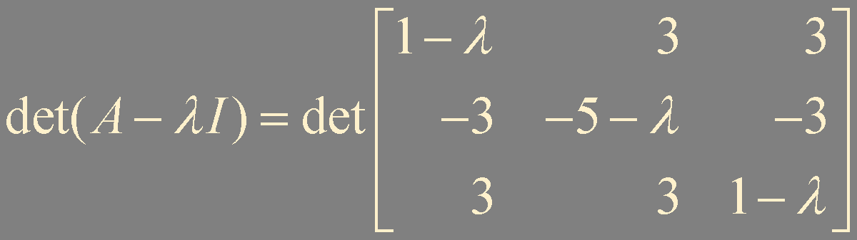
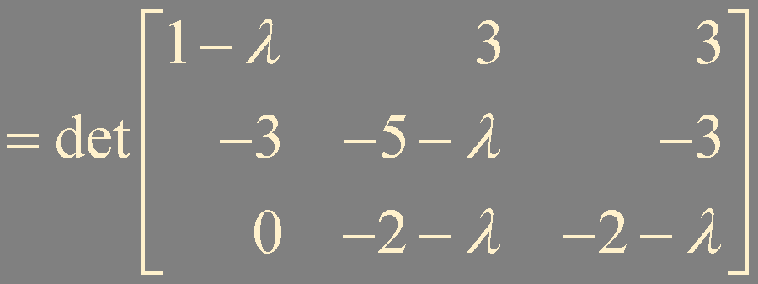



Example 2.
replacement : 1
interchange : -1
scaling : r
λ = 1
(multiplicity = 1)
λ = -2
(multiplicity = 2)

Slide 9






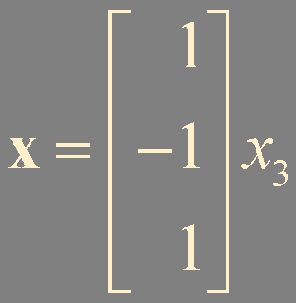




(A - λI) = 0
λ = 1
λ = -2
eigenspace dimension = 1
eigenspace dimension = 2
v₁
v₂
v₃
P = [ v₁ v₂ v₃ ]

Slide 10




Example 3.
λ = 1 with multiplicity = 1
λ = -2 with multiplicity = 2
basis for λ = 1
basis for λ = -2
🤷‍♂️
eigenspace dimension = 1
eigenspace dimension = 1

Slide 11

Theorem 5.
An n × n matrix with n distinct eigenvalues is diagonalizable.

Slide 12
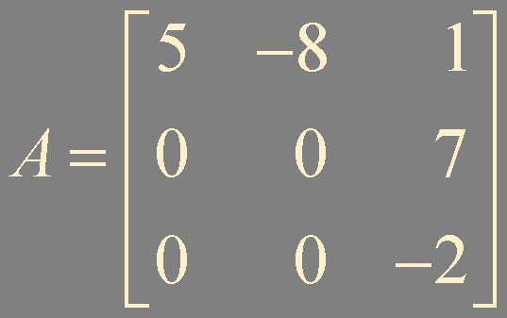

Example 4. Determine if the following matrix is diagonalizable

Slide 13
Theorem 6.
Let A be an n × n matrix whose distinct eigenvalues are λ₁, λ₂, …, λ_{p}
a. For 1 ≤ k ≤ p, the dimension of the eigenspace for λ_{k} is less than or equal to the multiplicity of the eigenvalue λ_{k}
b. The matrix A is diagonalizable if and only if the sum of the dimensions of the distinct eigenspaces equals n, and this happens if and only if the dimension of the eigenspace for each λ_{k} equals the multiplicity of λ_{k}

Slide 14

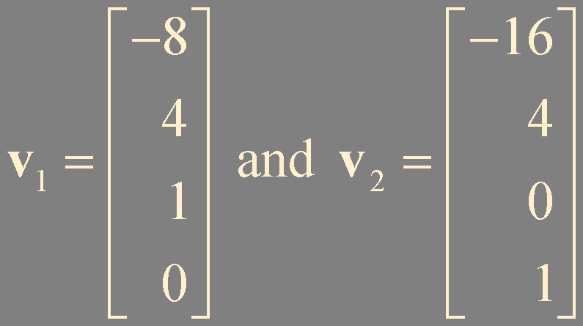
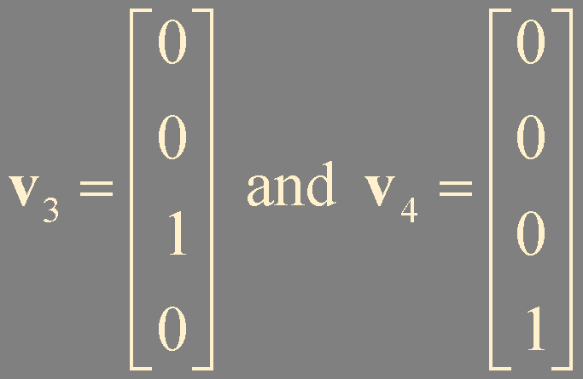
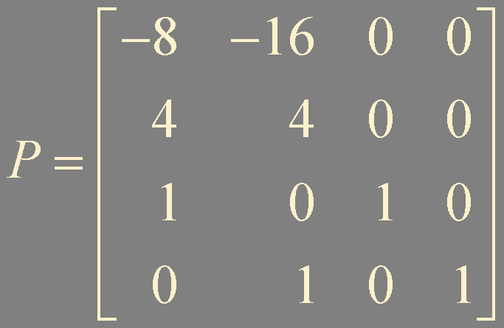
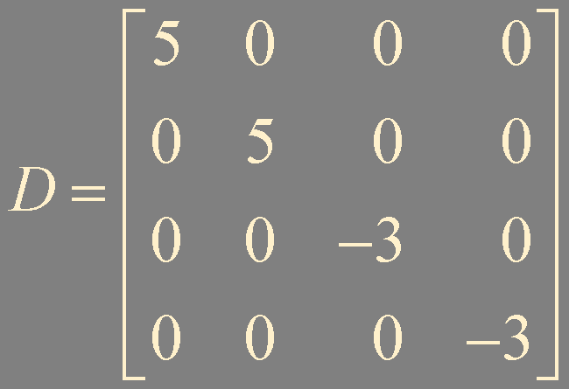
Example 5.
λ = 5 with multiplicity = 2
λ = -3 with multiplicity = 2
basis for λ = 5
basis for λ = -3
eigenspace dimension = 2
eigenspace dimension = 2
λ = 5
λ = 3

Slide 15


Example 6. True or False
A is diagonalizable if A has n eigenvectors
If A is diagonalizable, then A has n distinct eigenvalues
If AP = PD, with D is diagonal, then the nonzero columns of P must be eigenvectors of A
If A is invertible, then A is diagonalizable

Slide 16
Summary
Diagonalization

